Slide 1
Mini Project 1
Jianshi(Will) Li

Slide 2
Part 1: Transport For London API Exploration
Tools used: Jupyter Lab, TFL api
Packages used: requests os, json, IPython.display.JSON

Slide 3
Task: Tomorrow’s air quality forecast
My result:
'Low pressure fronts arriving from the Atlantic will affect the weather in Greater London. Staying mild, cloudy and generally breezy. Spells of rain likely, and could turn heavy at times. &lt;br/&gt;There&#39;ll be a fresh breeze to disperse local emissions and little imported pollution. &lt;br/&gt;&lt;br/&gt;Air pollution is expected to remain &#39;Low&#39; throughout the forecast period for the following pollutants:&lt;br/&gt;&lt;br/&gt;Nitrogen Dioxide&lt;br/&gt;Ozone&lt;br/&gt;Sulphur Dioxide &lt;br/&gt;PM10 Particulates&lt;br/&gt;PM2.5 Particulates'
Potential improvement:
Specify actual date rather than use ‘future’ in ‘forcastType’

Slide 4
Task: Find all sorts of modes supported by TFL and count how many
My result:
['bus', 'cable-car', 'coach', 'cycle', 'cycle-hire', 'dlr', 'interchange-keep-sitting', 'interchange-secure', 'national-rail', 'overground', 'replacement-bus', 'river-bus', 'river-tour', 'taxi', 'tflrail', 'tram', 'tube', 'walking']
Number of different modes of transport is 18

Slide 5
Task: Amount of BikePoints in London running by TFL and total #docks
My result:
781 BikePoints in London are operated by Transfor for London
20672 docks are in ALL BikePoints
Worth to mention:
Need to use sum() in order to calculate total docks.

Slide 6
Task: Tube & bus lines amount in London? All names for tube lines
My result:
687 tube and bus lines are in London!
['Bakerloo',
'Central',
'Circle',
'District',
'Hammersmith & City',
'Jubilee',
'Metropolitan',
'Northern',
'Piccadilly',
'Victoria',
'Waterloo & City']
Worth to mention:
I’ve never been to London. It took me a while to realize what tube is.

Slide 7
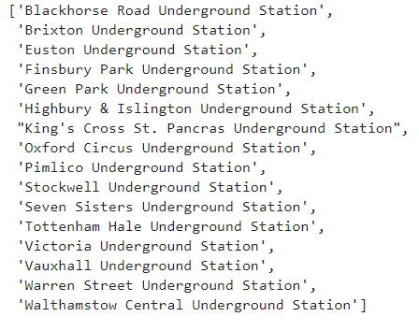
Task: How many stations are in line ‘Victoria’
My result:
Line "Victoria" has 16 stations!
Worth to mention:
They are:

Slide 8
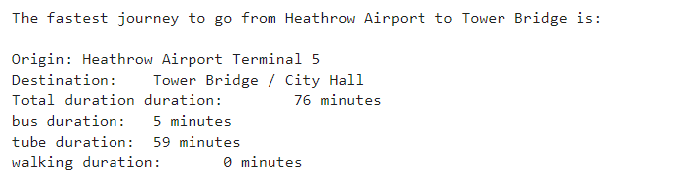
Task: Plan journey from two places using defined modes. Fastest journey?
My result:
Worth to mention:
I found all possible journeys…... And sorted them by duration…...

Slide 9
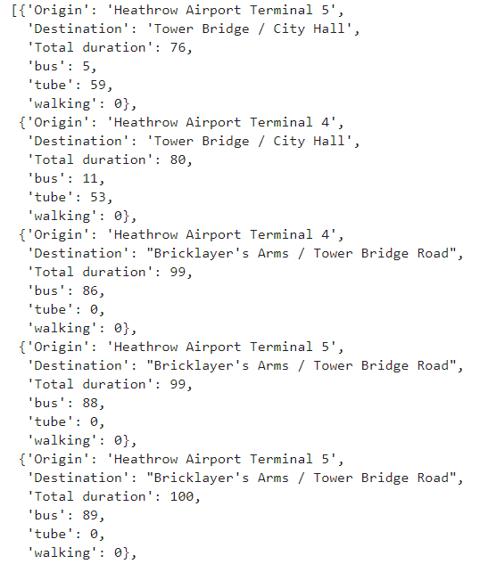
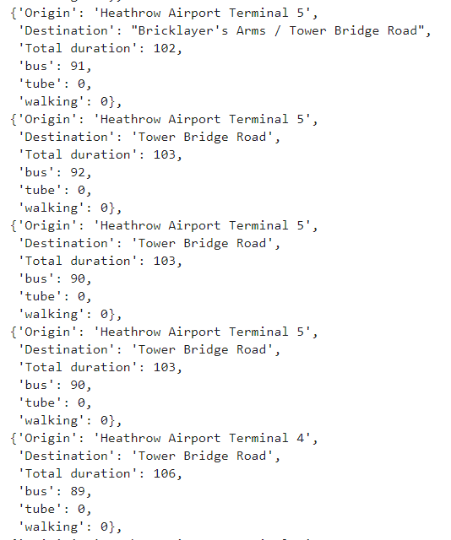

Slide 10
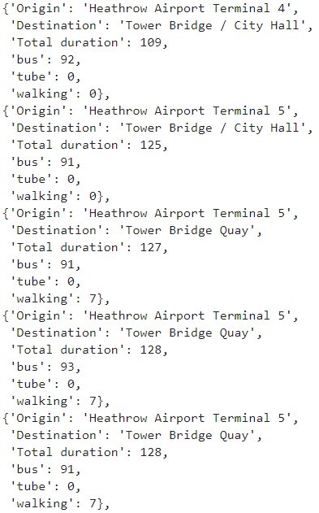
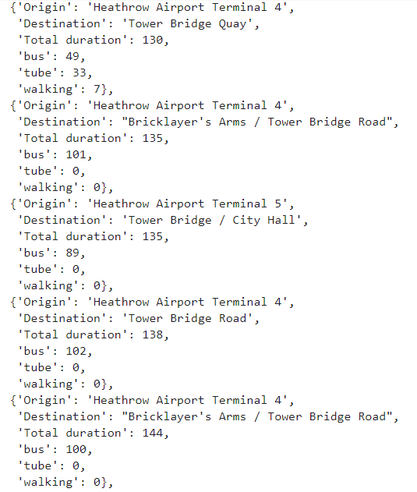

Slide 11
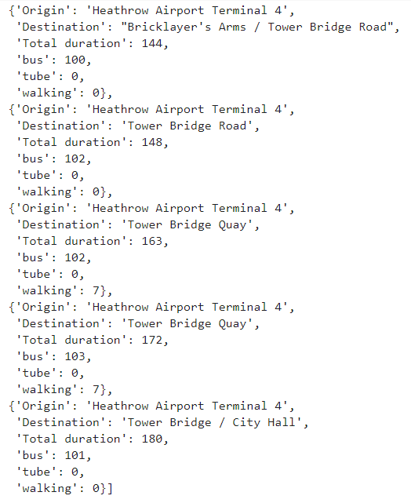

Slide 12
Biggest Challenges
There are multiple stations containing “Heathrow Airport” or “Tower Bridge”.
If I use them directly, I got status code 300.
How I solve:
I find all the stations containing those two keywords(or any other keywords).
Loop over all combinations.
Find all possible journeys

Slide 13
If I had more time, I will do:
Define more functions.
Try dumping json data into local files.
Make better looking slides!!!

Slide 14
Part 2: TMDB API Exploration
Tools used: Jupyter Lab, TMDB api
Packages used: requests, os, json, IPython.display.JSON

Slide 15
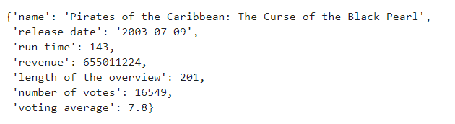
Task: Search favorite movie and list info
My result:

Slide 16
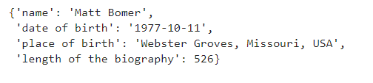
Task: Search favorite actor/actress and list info
My result:

Slide 17
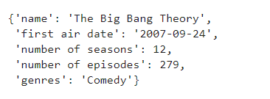
Task: Search favorite tv show and list info
My result:

Slide 18
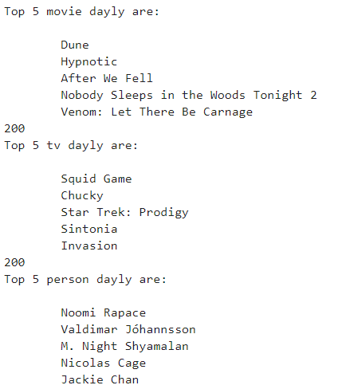
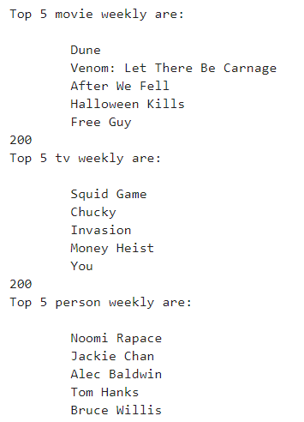
Task: Find Top 5 Trending of movie, tv and people
My result:
Daily: Weekly:

Slide 19


